Slide 1
Python Dictionary

Slide 2
Agenda
What is python dictionary?
Definition
Key-value
Working with python dictionary
How to create a dictionary
Access values in a dictionary
Dictionary manipulation
Dictionary methods

Slide 3
Python Dictionary
A type of built-in data structure in Python.
Python dictionary is an unordered collection of items.
Data stored in dictionary comes with key-value pairs not singly elements.
Key:
Each key is unique and connects to a value.
Key comes before value.
Used to access value associated with that key.
Value:
Can be access when key is known.
Can be duplicate among key-value pairs.
Value can be any type of object in python (int, float, list, dictionary, object, …)
A dictionary can store limitless amount of data.

Slide 4
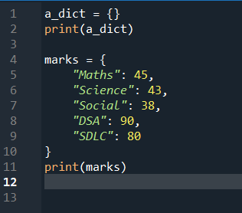
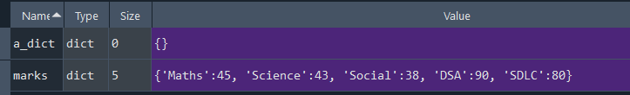
Creating a dictionary
Items inside a dictionary are placed in curly brackets {} and separated by comma
Value can be of any data types and duplicate
Keys must be of immutable data type and unique

Slide 5







Access values in dictionary
Dictionary uses keys to access values
Value can be access in two ways:
Direct: dict_name[key] -> throw KeyError if key not found
Via method: dict_name.get(key) -> return None if key not found

Slide 6
Dictionary manipulation
Add new elements
Change element’s value
Delete elements from a dictionary

Slide 7
Dictionary manipulation

Slide 8
Resources
List the resources you used for your research:
Source #1
Source #2
Source #3

